Slide 1

Career Opportunities in the Energy Industry
Addressing the concerns of early professionals and students
June, 2015

Slide 2
Presentation Outline
Industry Outlook (Section 1)
  Where is the market going in the near and long term?
  What are some of the causes of the current contraction?
Careers / Jobs in the Geosciences (Section 2)
  Geoscientist across the economy and in Government, Academia, and Industry
  Broaden you experience!
How to Get Started (Section 3)
  Personal Stories
    Story 1
    Story 2
  Interviewing
  Placement
  Networking
  Young Professionals (YPs)
Q&A Preparation Material and Additional Content

Slide 3
Note to VG Presenters
AGI asks AAPG VGs that utilize AGI sourced slides take a 1-hour free on-line workshop geared towards directing student discussions on career development in the geosciences.
It explains how best to talk about the AGI career wheel, interviewing techniques, and what amount of education best fits with the students long-term career goals. If further discussing the current downturn and avenues for career development.
Preparing our Workforce (POW)
http://www.americangeosciences.org/workforce
http://www.americangeosciences.org/workforce/pow-careers-discussion-course-registration

Slide 4
Career Opportunities in the Energy Industry
Addressing the concerns of early professionals and students
Section 1
Industry Outlook

Slide 5

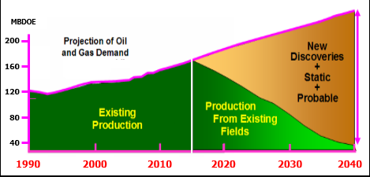
Challenge for the Upstream – today and beyond
Worldwide demand for energy will increase steadily out to 2035 and beyond
Projected demand for oil and gas in 2035 is 45% more than it is in 2015
BP Energy Outlook 2035
There is a huge GAP between projected production from existing fields and what needs to produced through 2040 to meet the demand
Courtesy of ExxonMobil

Slide 6
Global Population Growth
In Billion’s of People
Courtesy of BEG, Dr. S.Tinker, 2015
Notes:
Global population growth will increase demand for all energy types as well as a need for staff in the fields of hydrogeology, environmental engineering, geomorphology and other disciplines beyond pure exploration/subsurface geology

Slide 7
Source of Energy Demand
Courtesy of BEG, Dr. S.Tinker, 2015
Courtesy of ExxonMobil
Notes:
Demand growth will be primarily centered in Asia but have global impact on markets and university / hiring trends

Slide 8
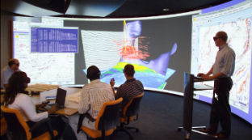
What We Need
We need to drill ‘good’ wells, ones that have low risk and maximize the return on our investments
Since wells can be very expensive, some cost more than $200 million, we must position each well with care
We need as accurate an understanding of the subsurface as possible so we can:
  Maximize oil & gas recovery from known fields
  Move probable & static assets to proven reserves
  Discover new reserves beneath & adjacent to known fields
  Find and produce oil & gas in new areas
Conclusion: The energy industry needs new geoscientists with the talent and drive to find, develop and produce the energy that people will need.

Slide 9

Oil & Gas Prices
The energy industry goes through cycles (of about 7 – 10 years)
These cycles are dictated by oil and gas prices and, while unfortunate, a byproduct of maintaining a balance of supply and demand
Right now prices are low and companies are tightening belts
2015/2016 will see a reduced number of job openings and internships
When prices rebound, the demand for new hires will increase greatly and students and young professionals will be well positioned
We have to wait for the sun to come out from behind the cloud – AND IT WILL!!

Slide 10
Challenge for the Upstream
Courtesy of ExxonMobil

Slide 11

Three BIG Positive Factors
Energy Demands
Technology Needs
Industry Demographics

Slide 12
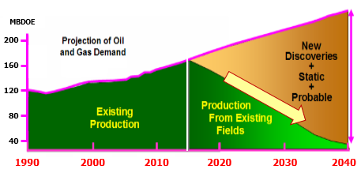
Demand UP, Production less certain
As You Have Seen…
BP Energy Outlook 2035
Geoscientists are Needed to Fill this GAP?

Slide 13
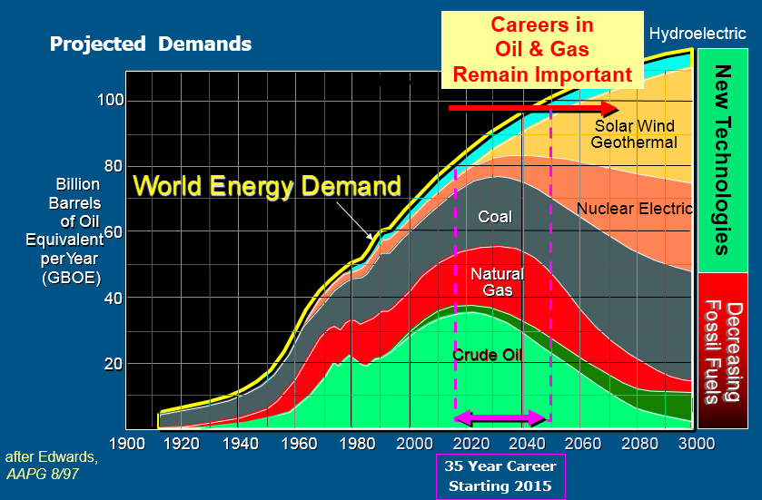
Sources of Energy Forecast

Slide 14
Technology Needs
To meet energy demands, we can’t count on simply making ‘giant new discoveries’
In addition to making new discoveries, we need to get more out of what we already have found:
  New life in old fields
  Make ‘uneconomic’ reserves economic
Technology, and the people to develop and apply it, will be the key

Slide 15
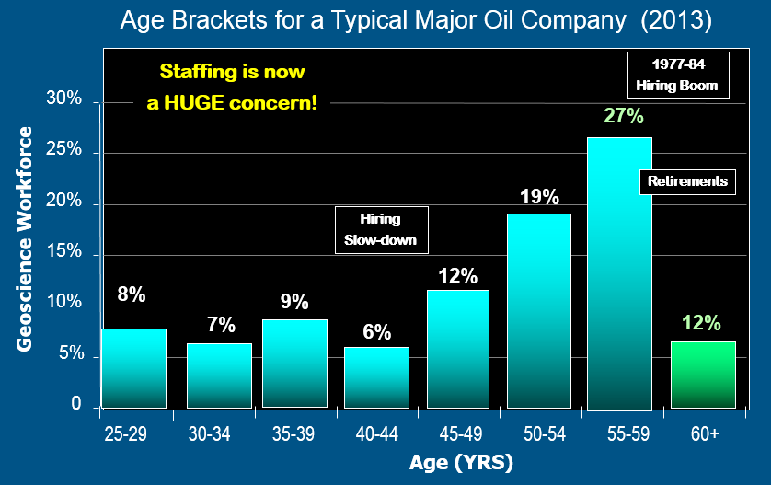
Industry Demographics

Slide 16
Career Forecasts – by 2021
262,627 geoscience jobs today
~130,000 geoscientists expected to retire by 2021
72,000 geoscience job growth by 2021 (BLS)
15,000 total new graduates (MS or PhD)
45,000 total new graduates if also hiring BS/BA
OR
Net deficit of over 150,000
geoscientists by 2021
And Eric M. Riggs

Slide 17

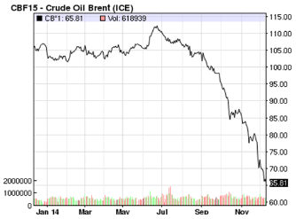

Two Major Concerns
Recent drop in the price of oil (down about 50%)
Price of Brent Crude Oil as of Dec 9, 2014
Number of Geoscience Majors is high
a recent AAPG/SEG Student Expo

Slide 18
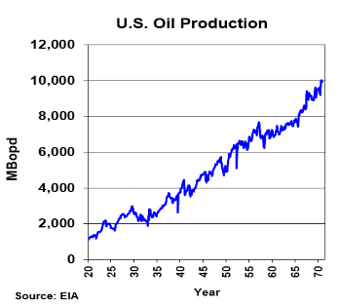
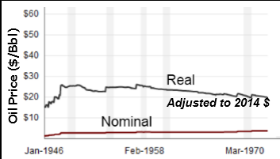
Some History: 1946 to 1970
US demand was less than our production capacity – the spigots were not open 100%
We did not require imported oil to meet our needs
Oil prices were quite stable

Slide 19
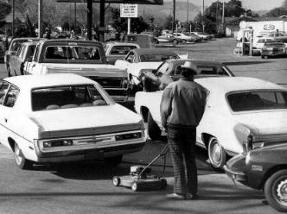
More Recent History: 1970 - 2014
US demand exceed US production capacity – the spigots were opened 100%
Henceforth we required imported oil to meet our energy needs
World economic and political events drive price extremes
  Concerns over supply disruptions
  Production quotes of suppliers
  World financial instabilities
  Production from Unconventionals
Late 1973
Oil Embargo led to long gas lines

Slide 20
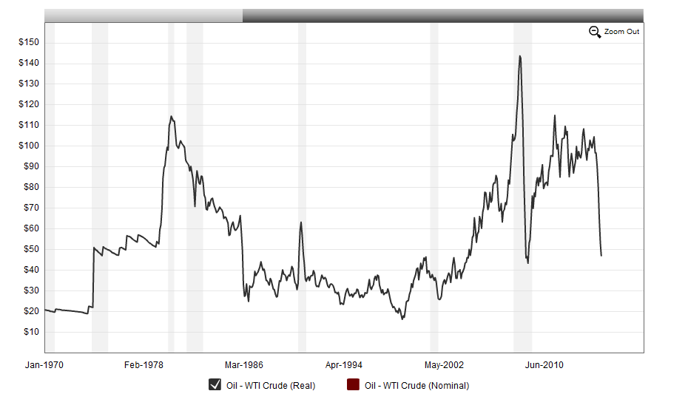
Oil Prices: 1970 - 1988
  Concerns over supply disruptions
  OPEC Production quotes of suppliers
OPEC
cut 50%
OPEC Prod.
@ 30 MMBpd
OPEC Prod.
Down to 15 MMBpd
OPEC Prod.
Up to 28 MMBpd
Iran/Iraq
War
Iranian
Revolution
OPEC Increases
Production to get more Mkt. Share
Oil Price $/Bbl
Cut in production keeps price above $20/barrel
Yom Kippur War
Oil Embargo
Real Oil Prices ($2014)
20

Slide 21
Oil Prices: 1988 - 2014
  Concerns over supply disruptions
  World financial instabilities
  Production quotes of suppliers
  Production - Unconventionals
OPEC Prod.
Up to 28 MMBpd
OPEC Prod.
Varies
OPEC Prod. Averages
30 – 35 MMBpd
Recession
Iraq War
PDVSA Strike
Asian Growth
Low OPEC Spare Capacity
Japan in Recession
Europe on Brink
Oil Price $/Bbl
OPEC Maintains
Production to
Retain Market Share
Gulf War
Arab Spring
Asian Financial
Crisis
9/11
Attacks
Oil Shale Growth
Real Oil Prices ($2014)

Slide 22
Current Price Collapse
  Significant production from unconventionals has added to our supply
  OPEC has not reduced production (as they traditionally would have)
  We have a slight over-supply (more produced in a day than consumed – exasperated by sluggish global economy)
  This has caused oil prices to drop ~50%
  Wells, especially in unconventional fields, are being shut in, which will lower daily production and eliminate over-supply
  With time, supply and demand will come back into balance and prices will stabilize at $__ /barrel
?

Slide 23
Now – The bright side!
  Hiring will be hampered over the short term, but those new to the workforce are the ones able to capitalize on the next upturn!
  While many areas of the industry are affected (especially service and exploration companies), the geoscience community is far more diverse than in previous downturns, and many opportunities are available in government, academia, and other areas of the hydrocarbon pipeline.
  And, as upstream companies are cutting because of oversupply, downstream companies are profiting on the growing hi-demand of products – US motorists aren’t slowing down!
  Demographic trends continue to work in the favor of early career professional’s over the long run.
  Global, and increasingly, American energy production and demand remains positive and geologist will be needed to continue that trend.

Slide 24
Now – The bright side!
The largest percentages of those released are those over 55 or with less than 5 years of experience – with many those over 55 not returning when hiring returns only exasperating the problem of the lack of talent to replace the
retiring late-career professionals -
Oil prices have stabilized and even appear to have begun to rebound slightly, students that can make it through the next year/18 months are positioned nicely for the next recovery!

Slide 25

Energy Outlook – BP Summary to 2035
Continuous change is the norm for energy markets
Changing energy mix
    gas fastest growing fossil fuel, coal the slowest
    continued rapid growth in renewables
Changing energy trade patterns
      increasingly flowing from West to East
Changing the carbon emissions path?
  no silver bullet, need action on many fronts
  let the market pick the winners
BP Energy Outlook 2035 BP p.l.c.2-15
Notes:
25
At a time when our industry is focused on the rapid response to a dramatic fall in oil prices, it is instructive to look at events from a longer term perspective.
Energy companies need to adapt; and to build strategically for the longer term we not only need to control capital and costs, but to set a clear direction. This Outlook is therefore valuable in giving us an insight into the most likely shape of the future energy landscape and some of the most important changes expected over the next 20 years.
First, trade patterns are shifting. The strong growth of US tight oil in recent years has had a dramatic impact, with oil increasingly flowing from West to East rather than East to West. This is likely to continue, with strong growth in China and India driving energy demand. We also expect to see the market in gas become more global as liquefied natural gas (Second, the energy mix continues to shift. Fossil fuels are projected to provide the majority of the world’s energy needs, meeting two-thirds of the increase in energy demand out to 2035. However, the mix will shift. Renewables and unconventional fossil fuels will take a larger share, along with gas, which is set to be the fastest growing fossil fuel, as well as the cleanest, meeting as much of the increase in demand as coal and oil combined. Meanwhile, coal is now expected to be the slowest growing fuel, as industrialization in emerging Asian economies slows and environmental policies around the globe tighten
That brings us to the environmental challenge. The most likely path for carbon emissions, despite current government policies and intentions, does not appear sustainable. The projections highlight the scale of the challenge facing policy makers at this year’s UN-led discussions in Paris. No single change or policy is likely to be sufficient on its own. And identifying in advance which changes are likely to be most effective is fraught with difficulty. This underpins the importance of policy-makers taking steps that lead to a global price for carbon, which provides the right incentives for everyone to play their part.
It will be a year of debate, not only on the environment, but the economy and energy in general

Slide 26
Continuous change is the norm
in the energy industry
Today’s turbulence is a return to business-as-usual.
The energy mix changes.
The balance of demand shifts.
New sources of energy emerge, such as shale gas, tight oil, ultra-deep water oil or renewables.
Economies expand and contract.
Energy production and consumption are affected by disruptions, from wars to extreme weather.
New policies are created to address climate change or bolster energy security.
BP Energy Outlook 2035 BP p.l.c.2-15
Notes:
Energy companies need to adapt; and to build strategically for the longer term
we not only need to control capital and costs, but to set a clear direction.
This Outlook is therefore valuable in giving us an insight into the most likely shape of the future energy landscape and some of the most important changes expected over the next 20 years.

Slide 27
Global population and increases in income per person underpin growing energy demand
Population
GDP
Contribution to GDP growth 2013-35
OECD - Organization of Economic Co-Operation and Development Countries
Billion
Trillion, $2011 PPP
Trillion, $2011 PPP
Other
Non-OECD Asia
OECD
BP Energy Outlook 2035 BP p.l.c.2-15
Notes:
Population growth and increases in income per person are the key drivers behind growing demand for energy.
By 2035, the world’s population is projected to reach 8.7 billion, which means an additional 1.6 billion people will need energy.
Over the same period, GDP is expected to more than double, with non-OECD Asia contributing nearly 60% of that growth.
Globally, GDP per person in 2035 is expected to be 75% higher than today, an increase in productivity which accounts for three-quarters of global GDP growth.
China and India are key drivers of non-OECD growth and are projected to grow by 5.5% per annum (p.a.) between 2013 and 2035.
By 2035, they will be the world’s largest and 3rd largest economies respectively, jointly accounting for about one-third of global population and GDP.
As China’s level of productivity catches up with the OECD, its rate of growth is expected to slow from 7% p.a. in this decade to 4% p.a. in the decade to 2035.
India’s growth moderation is more gradual: slowing from 6% p.a. in this decade to 5% p.a. in the final decade.

Slide 28
Fossil fuels support most of the world’s energy even as it shifts towards lower carbon fuels
Shares of primary energy
2013-35 increments by fuel
Billion TOE (tons oil equivalent)
Oil
Coal
Gas
Hydro
Nuclear
Renewables*
OECD
*Includes biofuels
BP Energy Outlook 2035 BP p.l.c.2-15
Notes:
Gas gains share steadily, while the shares of both oil and coal fall.
By 2035 all the fossil fuel shares are clustered around 26-28% with no single dominant fuel – a first since the Industrial Revolution.
Fossil fuels in aggregate lose share but remain the dominant form of energy in 2035 with a share of 81%, down from 86% in 2013.
Among non-fossil fuels, renewables (including biofuels) gain share rapidly, from around 3% today to 8% by 2035, overtaking nuclear in the early 2020s and hydro in the early 2030s.
Roughly one-third of the increase in energy demand is provided by gas, another third by oil and coal together, and the final third by non-fossil fuels.
In the OECD, declines in oil and coal are offset by increases in gas and renewables, in roughly equal parts.
Growth in non-OECD energy is evenly spread, with roughly a quarter each for oil, gas, coal and non-fossil fuels.

Slide 29
The power sector takes an increasing share of energy and plays a key role in the energy mix
Inputs to power as a share of total primary energy
Primary inputs to power
Oil
Coal
Gas
Renew.
Nuclear
Hydro
BP Energy Outlook 2035 BP p.l.c.2-15
Notes:
Power generation is expected to account for an ever-increasing share of primary energy consumption as the world continues on a long-term trend of electrification:
the share rises from 42% today to 47% by 2035.
Power generation is the one sector where all fuels compete and so will play a major role in how the global fuel mix evolves.
There have been some rapid shifts in fuel shares in power generation in the past: oil gaining in the 1960s and losing in the 1970s; nuclear picking up in the 1970s/80s and falling in the 2000s; gas rising through the 1990s and 2000s.
The largest shifts are the increase in the renewables share and the decline in the coal share.
The outcome by 2035 is a more balanced and diversified portfolio of fuels for power generation.
Coal remains the dominant fuel, accounting for more than a third of the inputs to power generation, but that share is down from 44% today and the gap between the shares of coal and of other fuels narrows significantly.

Slide 30
Share of power from non-fossil fuels increases driven by the rapid growth of renewables
Share of world power generation
Growth of non-fossil power
Thousand TWh (tera-watt hours)
OECD
Non-OECD
Total non-fossil
Hydro
Nuclear
Renewables
1991-2013
1991-2013
2013-2035
2013-2035
BP Energy Outlook 2035 BP p.l.c.2-15
Notes:
Until recently, the share of non-fossil fuels in global power generation was declining as nuclear and hydro struggled to keep pace with the growth of global power generation, and renewables were too small to make a material difference.
Looking ahead, the shares of nuclear and hydro continue to decline, but the scaling up of renewables is sufficient to lift the aggregate non-fossil share from 32% in 2013 to 38% by 2035.
Within the OECD, renewables dominate the growth of non-fossil power, and contribute 90% of the net growth in power generation from all sources.
The growth of non-fossil fuels in the non-OECD is broader based.
The increase in renewable power is roughly the same in volume terms as in the OECD. But there are also significant increases in nuclear and hydro.
Renewables account for 16% of the growth in power generation in the non-OECD.

Slide 31
Carbon emissions are rising too fast for comfort which could trigger additional abatement policies
Emissions by sector
Options that achieve equal CO₂ emissions reductions*
Billion tonnes CO₂
Abatement option | Change required
Replace coal with gas in power (% of total power) | 1%
Add CCS to coal power plants (% of total power) | 0.7%
Increase renewables power generation | 11%
Increase nuclear power generation | 6%
Improve vehicle efficiency | 2%
Improve ‘other sector’ energy efficiency | 1%
Improve efficiency of electricity production | 1%
* Normalized for a 1% swing in the coal/gas mix in power generation, equivalent to 110 Mt CO₂. Estimates are based on energy shares in 2013.
BP Energy Outlook 2035 BP p.l.c.2-15
Notes:
Put differently, relative to a “no change” case: gains in energy efficiency lead to a far greater reduction in projected emissions than improvements in the fuel mix.
Global CO₂ emissions from energy use grow by 25% (1% p.a.) over the Outlook. Emissions remain well above the path recommended by scientists, illustrated by the IEA’s “450 Scenario”. In 2035, CO₂ emissions are 18 billion tonnes above the IEA’s 450 Scenario.
The projections are based on our view of the most likely evolution of carbon related policies, but future climate policies are a key uncertainty in the Outlook. There are a number of options open to policy makers if they decide to further abate carbon emissions.
The table considers a list of potential options, with a comparison of the extent of change required to achieve the same emissions savings as a 1% shift in the coal/gas mix of the power sector.
The list is not exhaustive.
The options include those that: limit emissions from coal in the power sector; increase non-fossil fuel use; and improve energy efficiency.
Responsible production and consumption of fossil fuels is a bridge to a lower carbon future
End use efficiency is the most potent and immediate source of GHG mitigation today
Technology and policy deployment can accelerate the future
Solutions will vary significantly by region

Slide 32
Outlook for Careers in the Geosciences
While the current price collapse has slowed oil and gas hiring in the short- term, long-term career potential is strong based on growth in population and gross energy demand.
The changing energy mix is producing new career opportunities
Careers in government, non-profit, and academia are less affected by oil. and gas prices and provide alternately rewarding career paths.
Cyclical hiring trends are the norm in this industry, the high-reward of working in this industry is tempered by periodic corrections – Don’t panic, and use these times to learn new skills and make new connections, and be stronger when the cycle corrects to the upturn.
The demographics of experienced professionals exiting the industry and without a sufficiently large mid-career workforce dictates the need for future new hiring and an excellent opportunity for students and YPs to capitalize.
Notes:
Energy companies need to adapt; and to build strategically for the longer term
we not only need to control capital and costs, but to set a clear direction.
This Outlook is therefore valuable in giving us an insight into the most likely shape of the future energy landscape and some of the most important changes expected over the next 20 years.

Slide 33
Career Opportunities in the Energy Industry
Addressing the concerns of early professionals and students
Section 2
Careers in Geosciences

Slide 34
Outline
Industry Context (Section 1)
  Where is the market going in the near and long term?
  What are some of the causes of the current contraction?
Careers / Jobs in the Geosciences (Section 2)
  Geoscientist across the economy and in Government, Academia, and Industry
  Broaden you experience and reach your desired level of education
How to Get Started (Section 3)
  Personal Stories
    Story 1
    Story 2
  Interviewing
  Placement
  Networking
  Young Professionals (YPs)
Q&A

Slide 35
What do you want in a career?
During challenging times – We must evaluate whether the oil and gas industry is the one we want to work in?
Are there other industries or experiences that you would like to tackle when work is less prevalent in the traditional exploration path? Can that make you a better professional? Geosciences and technical abilities compliment many industries – Where are exciting opportunities outside of the geosciences?
During contractions in the market – academic organizations may typically look to recruit those that went to industry during better times. Does the independence, flexibility, and ability to publish excite you? An opportunity to extend study and make a name with research.
Work for the government? Exciting and wide ranging jobs exist in energy and geoscience in the government/non-profit space.

Slide 36
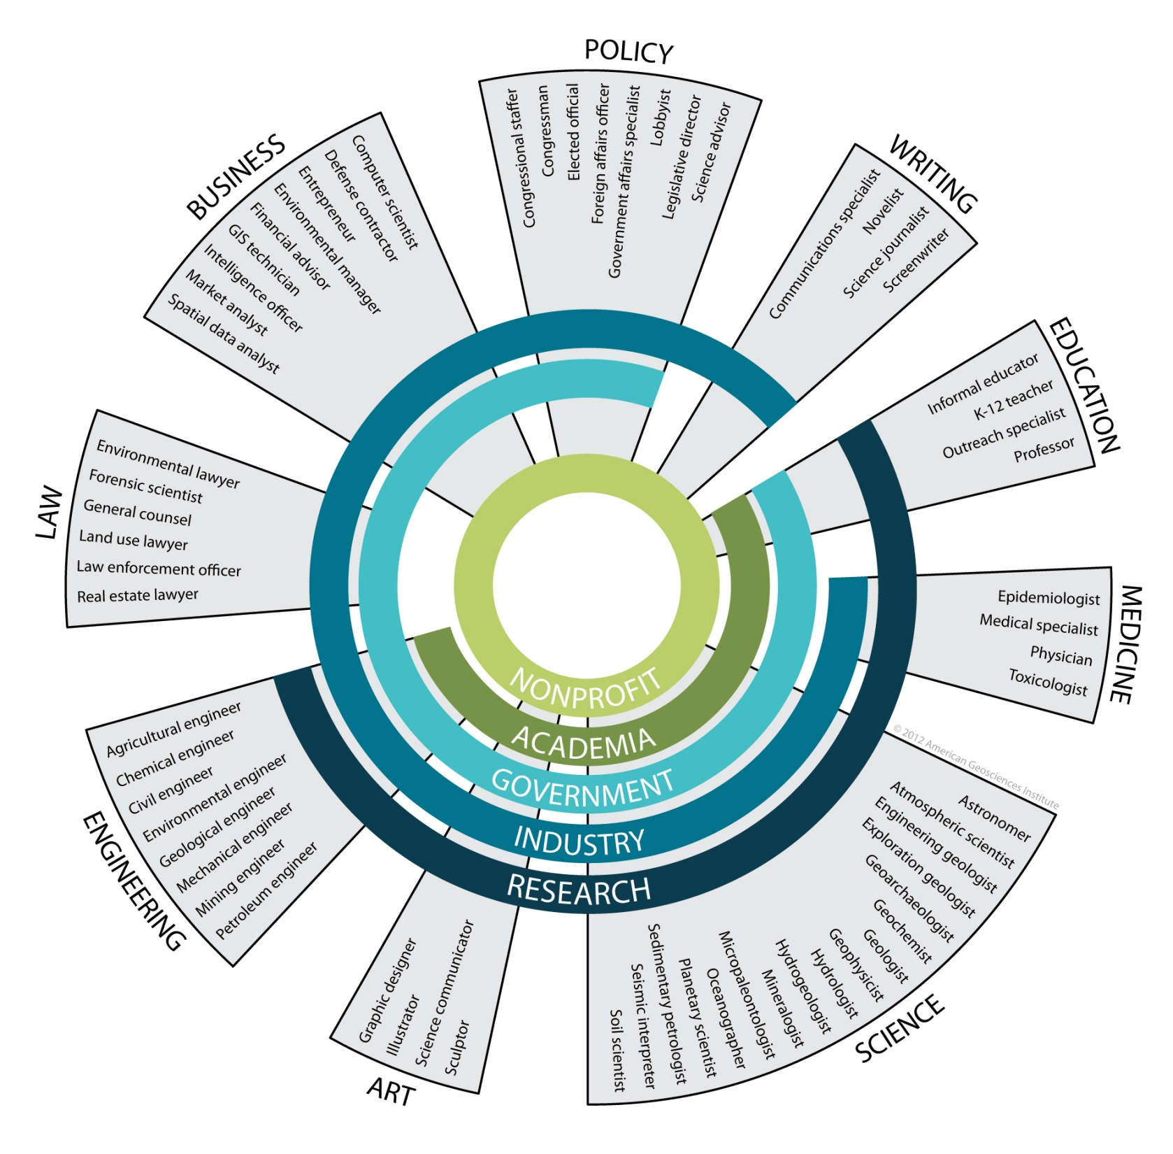
Think
Outside
the Box!
Notes:
Probing questions:
Do any of these surprise you? Stand out?
Have you ever heard of or met someone with an unusual or non-traditional field?
What have we missed? Can you think of any other occupations that you’d like to be included?
Do you disagree with any of these? How so?
Medicine:
Deals with the relationship between geological factors and health problems in humans, animals and plants.
Health problems they work with include exposure to toxic levels of mercury and arsenic
Exposure to natural dusts and radioactivity
Health effects of dust and particulates in the air after volcanic eruptions
Health effects of asbestos
Epidemiologist: study of patterns, causes and effects of health and disease within a population. Basically a health researcher.
Finance:
Work on Wall Street – you need geoscientists who can evaluate the technical veracity of an investment but who can also communicate with the finance community so they can properly assess the risk and return of an investment.
Policy:
Legislative Assistant – they go to hearings and briefings about science issues that are important to their congressional office.
Law:
Forensics – they need geo’s because they can do some of the soil and sediment analysis on the bottom of ppl’s shoes to determine where they were. They look at the origin of particular materials. The examiner needs a broad knowledge of the geology and geo/soils maps to determine the location of soil that is found on a body if it does not match its location.
Geo’s can also identify locations as given by outcrops – the story about how a geologist could determine the location of Osama Bin Laden because of an image of an outcrop behind where he was standing in a video aired on CNN.
You can work for the FBI in their laboratory analyzing soil samples. Identification is important during mining, mineral or gem fraud so geo’s can determine if the material is what its sellers claim it to be.
Art:
Science Illustrator/Communicator – like Kat.

Slide 37
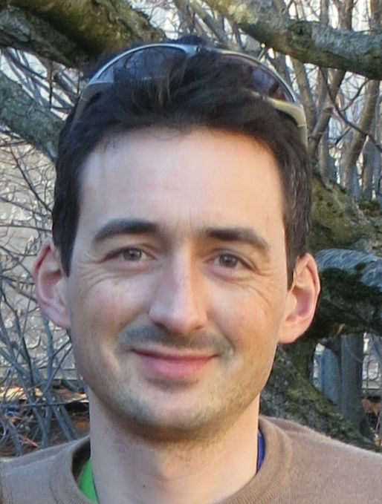
Career success doesn’t have to be limited to Energy!
Thomas Kocher
Was with Shell in the Netherlands and now with an insurance company in Switzerland.
Current position; risk engineer, providing the insurance business with a risk assessment perspective of the activities of their clients (petroleum companies across the upstream and downstream industry). His activity includes looking at exploration and well plans, assessing well integrity management program, surveying offshore installation or refineries.
“Studying geoscience and spending time in the oil industry has taught me a number of valuable skills to bring to the table in insurance: a broad general knowledge of the petroleum industry, familiarity with the terminology and mindset of our clients, strong analytical skills, and a deep technical knowledge of safety critical domains…”

Slide 38
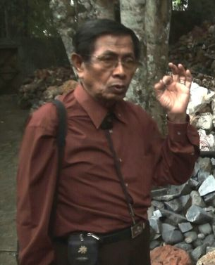
Career success doesn’t have to be limited to Energy!
Sujatmiko
Was with Total-Indonesia and now busy with a gemstone business in Indonesia.
Initially it was just a hobby but in 1989 Sujatmiko formed a company, GEM-AFIA. Through this company he promoted gemology and helped people improve their knowledge and skill on gemstones.
“I’d suggest the young generation to see gemology as a business opportunity in the future. If you don’t have any skill, it will be difficult to start a new business”

Slide 39
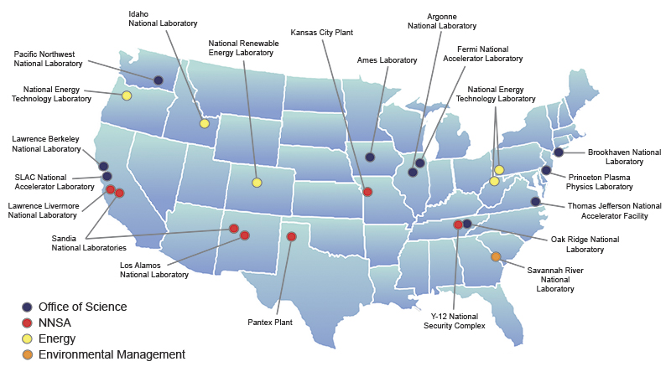
Expand beyond traditional industry jobs
Consider careers in government and pure research.
  National Labs
  Research institutions
  USGS
  BOEM
  BLM
  Department of
  State
www.usajobs.gov
Will be
X

Slide 40






University Careers in Geosciences
University Research positions are
immensely rewarding
  Self-directed research
  Opportunities to publish and present
  Extended field work
  Teaching and mentoring
  Collaboration with colleagues
  Career stability
  Typically moderately-lower salaries, need history
  of publishing, and more challenging to find openings.

Slide 41
Which Degree Should I Get
BS or BA
  A geotech for a large company, not recruited
  In the trenches for a small company
Masters
  Bulk of people in industry
  Able to hold any position, may be hard to get into a research role initially
PhD
  Can be important for academia and research, but less so for exploration and development
  Advisable if you want to do applied research for a mega-company
  Advisable if you may want to become a Professor/Research Sci
  Small difference in starting salaries for 2+ more years

Slide 42
How Can I Prepare?
Undergrad Level
  Excel in all your courses – high GPA
  Take fundamental, classic geoscience courses
  Get exposure to all disciplines – attend seminars
  Scan professional society journals – take note of who is working on topics that interest you
  ASAP decide on a sub-discipline
  Choose a “senior topic” that you have a lot of interest in, work it well, be creative and application-minded
  Search for undergraduate research position at the university or internships away from school

Slide 43
How Can I Prepare?
Grad Level
  Choose a high-caliber university with a great geoscience department
  Excel in all your courses – high GPA
  Take courses that will give the depth & breadth
  Look for way to demonstrate leadership potential
  Get some good work experience – internship
  Choose a research topic that we have passion for; better to have a superb thesis topic on something unrelated to industry than a mediocre thesis
  Gain interviewing experience, Polish your resume/CV – sell yourself
  Get active in the school’s Student AAPG group and participate in IBA
  Go to the local Prof. Geological meeting get to know the local geoscientists
  Present research work whenever possible; posters, oral, symposia..

Slide 44
What does this all mean for today’s graduating geoscientists
Careers in Geosciences remain important
  Petroleum and minerals are cyclical industries that go through periods of hiring and lay-offs.
  Roles of geologists have diversified greatly over the past 30 yrs.
Long term
  We will need a lot of geoscience professionals to replace those retiring and to accommodate the predicted job growth.
Short term
  Currently it is a time when companies are cutting expenses
  Starting a career in the short term may be challenging
  Companies will be very selective
  Great qualifications and a lot of effort
When oil prices rise and stabilize, hiring will spike to make up for the slowdown
Notes:
If you are a bright graduate with a demonstrated record of being committed to your chosen field in the geosciences, you will find a good job regardless of the macroeconomic factors at play.

Slide 45
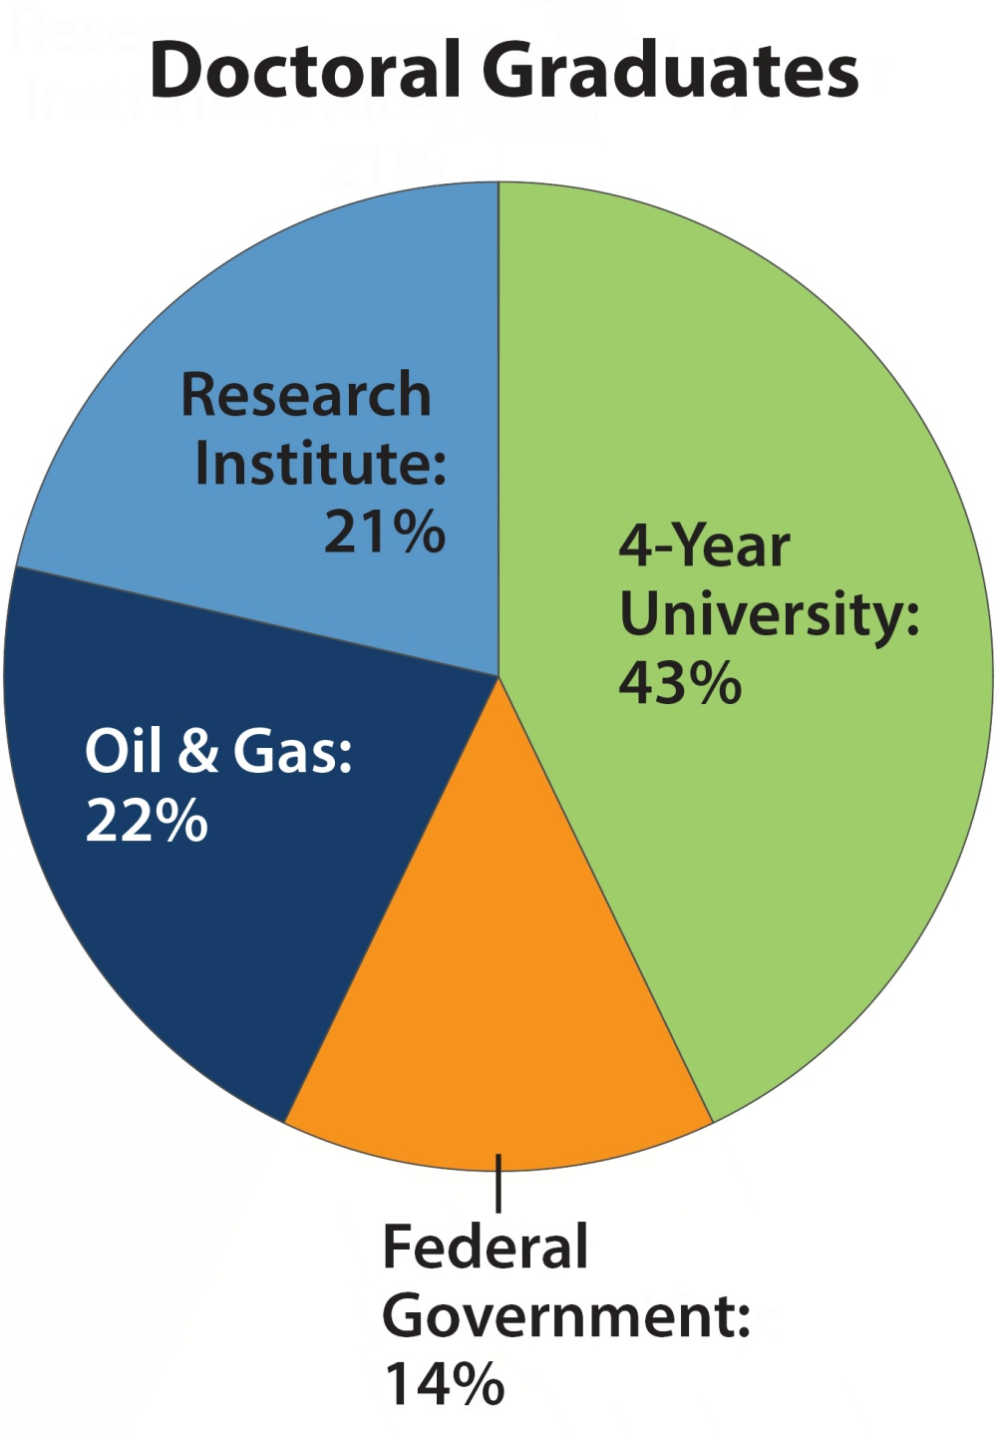
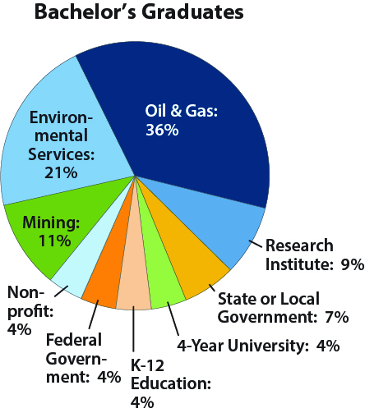
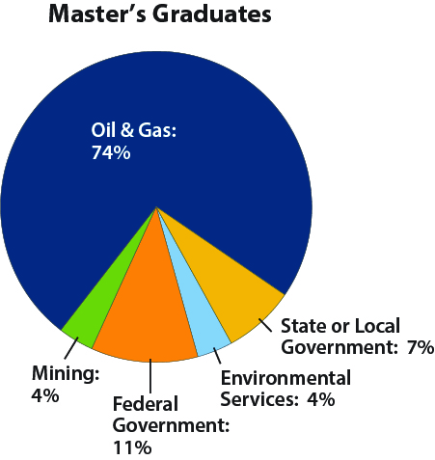
The Breakdown: Workforce Trends
Industries where graduating students have accepted a job in the geosciences
Industries where graduating students have accepted a job in the geosciences
Industries where graduating students have accepted a job in the geosciences
Source: AGI Workforce Program, 2013

Slide 46
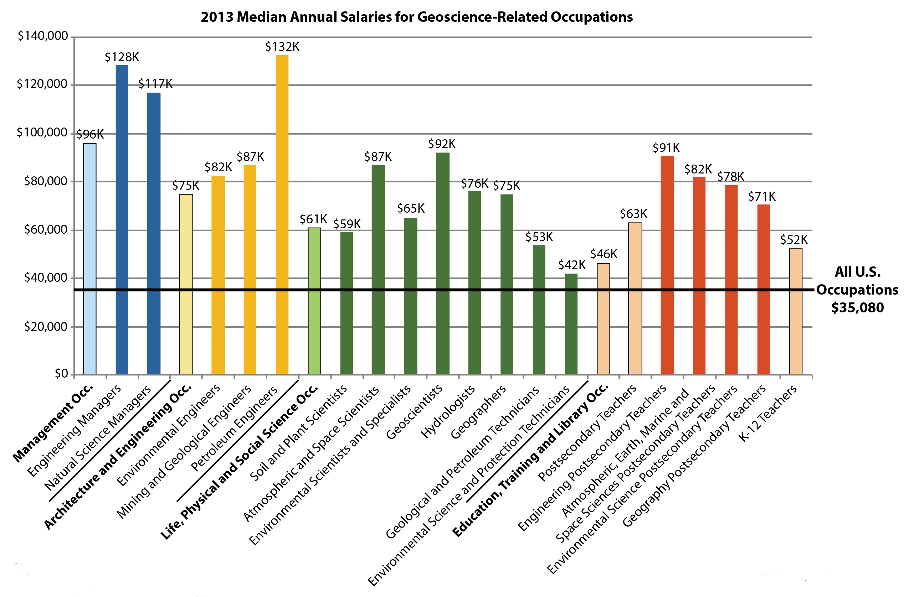
The Breakdown: Workforce Trends

Slide 47
Recent Oil and Gas Industry Salaries:
0 – 2 Years Experience
Average Salaries
0 – 2 Years
Salaries by Degree
0 – 2 Years (2014)
B.S | M.S | Ph.D.
$92,000 | $104,400 | $117,300
Source: AAPG Explorer

Slide 48
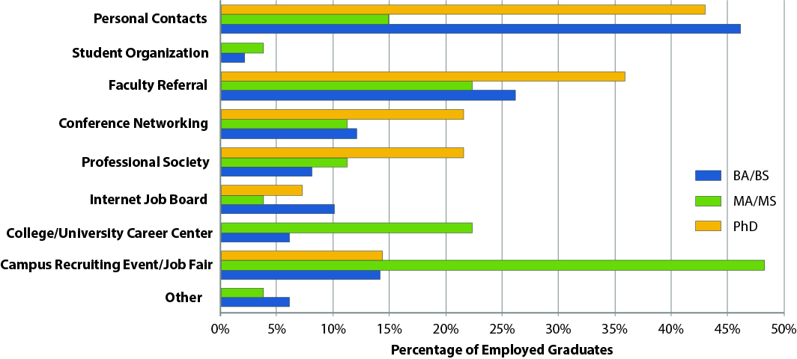
The Breakdown: Workforce Trends
Resources identified by students as useful for finding geoscience jobs
Source: AGI Workforce Program, 2013
Notes:
Stop – Say that they can interrupt me at any time and ask questions – this is a discussion.
Give them time to read the graphs
Good metric for health
This basically shows our supply of geoscientists
Oil boom and bust
BA/BS trucking along at 3K, MS at 1K and PhD at ~700….
In 80s, we had that huge demand, and it was met until the market crashed….
Now we have another huge demand – in different areas – but we don’t see enrollments drastically increasing…

Slide 49
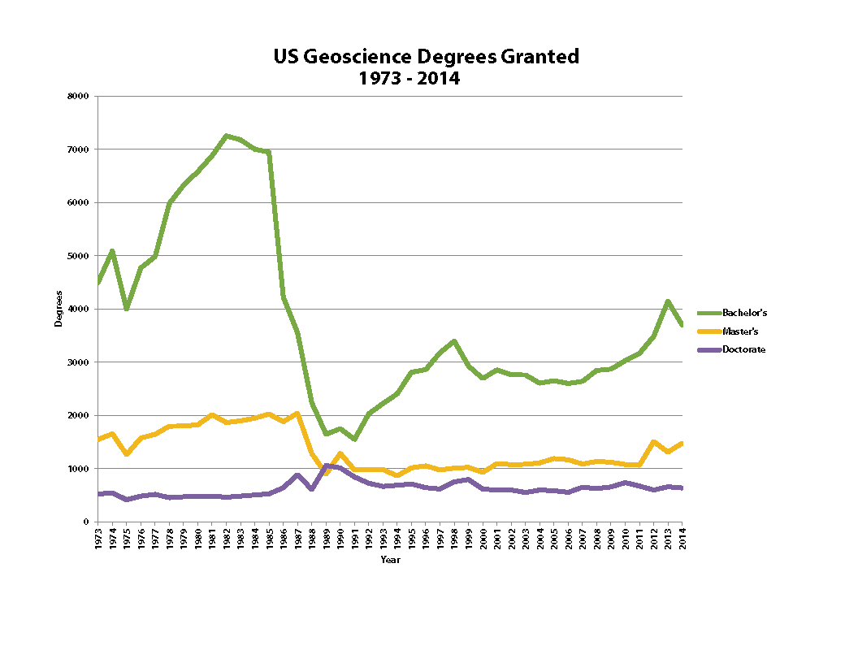
The Breakdown: Workforce Trends
Source: AGI Workforce Program, 2015
Notes:
Stop – Say that they can interrupt me at any time and ask questions – this is a discussion.
Give them time to read the graphs
Good metric for health
This basically shows our supply of geoscientists
Oil boom and bust
BA/BS trucking along at 3K, MS at 1K and PhD at ~700….
In 80s, we had that huge demand, and it was met until the market crashed….
Now we have another huge demand – in different areas – but we don’t see enrollments drastically increasing…

Slide 50
Things to Consider for a First Job
Salary, vacation, work hours
Location
People & facilities
Training program
Benefits, includes a pension
Job and work environment (Government, non-profit, Industry, or Academia
Stability
Bureaucracy
Initial assignment
Opportunities to grow/move
Notes:
Was there a certain reason you wanted to work for BP or was it just that you got hired there?
I chose BP (Sohio) out of 24 job offers!
So why did I pick BP?
In the final analysis the decision was very simple. I liked the people I met at BP. They were smart, bright, vibrant people who seemed to really enjoy what they did. They challenged each other and seem to relish in debating ideas.
The other quality that struck me at the time was that everyone had different ideas that the freely expressed. I felt that there was room for diversity. Diversity of being, and also diversity of thought. This initial perception has actually passed the test of time. Today we are working at making inclusiveness fundamental to how we work.

Slide 51
Big vs. Small Companies
A BIG company
  Competition is great
  Work with great minds
  Pressure to perform
  Can specialize
  Able to shift a lot
  May rank below average
  No special treatment
  Mega-bureaucracy
A SMALL company
  Competition is still high
  Work more friendly
  A bit less pressure
  Jack of all trades
  Not much latitude
  May rank above average
  Individual rewards
  Less bureaucracy

Slide 52
What If I Graduate Soon?
A Two-Pronged Strategy
ENERGY INDUSTRY
  Market yourself to industry
  Apply online
  Polish CV
  Prepare poster
  Present at Expos
  Interview when possible
  Network
  Attend professional society meetings
  Be seen, shake hands, etc.
OTHER INDUSTRIES
  Market yourself as:
  An accomplished scientist
  A skilled data analyst
  Highly computer literate
  An educator
  Someone interested in business & finance
  Other skills and areas of interest you have acquired

Slide 53
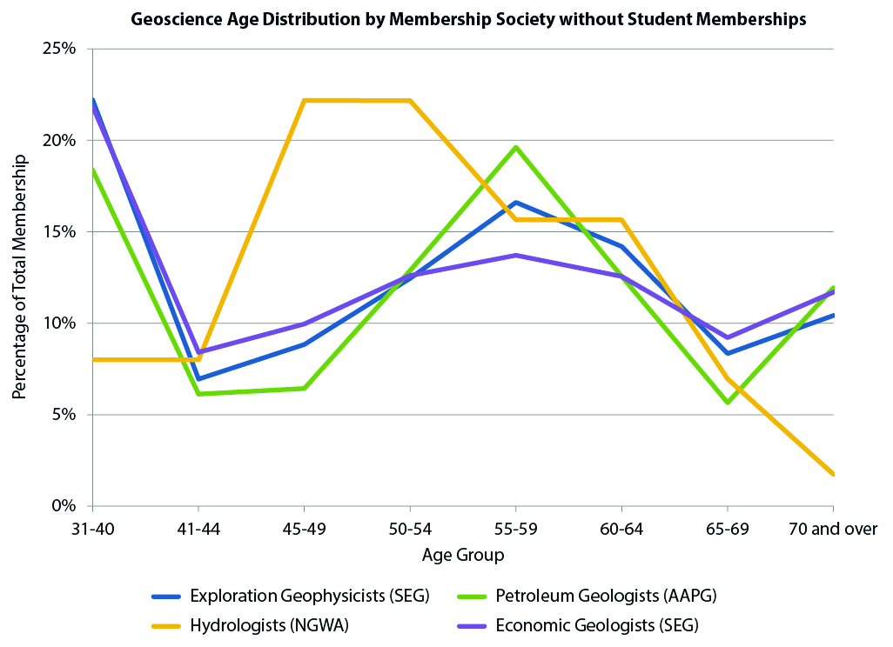
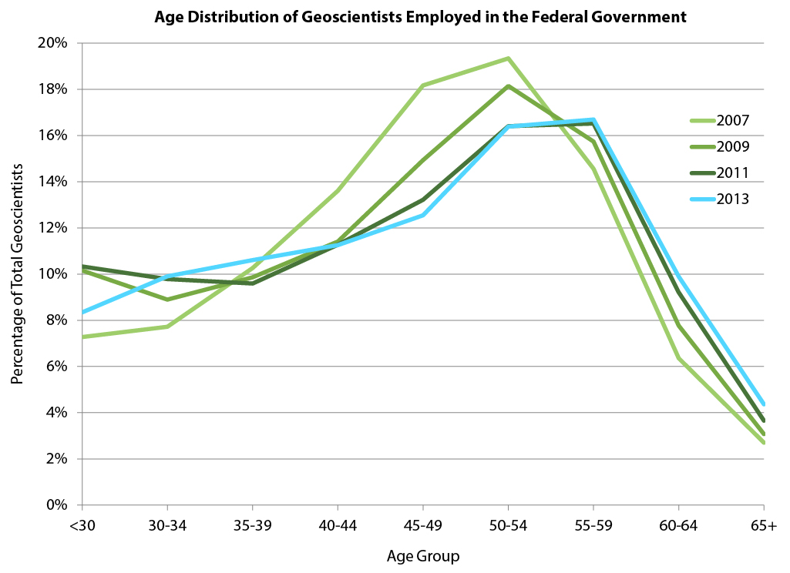
Attrition, Growth and Replacement in the next 10 years in the U.S.
297,000 geoscience jobs exist today (BLS)
143,000 geoscientists expected to retire by 2022 (AGI)
43,000 geoscience job growth by 2022 (BLS)
16,000 new MS/PhD + 35,000 BS/BA graduates (AGI)
51,000 total new graduates (with BS, MS and PhD)
Equals
Net deficit of over 135,000 geoscientists by 2022
Notes:
Good representation of WF – high % of 31-40 year olds…we’re seeing an influx of new people. The societies have been working on recruitment and marketing, so some of the percentages are high for younger age groups.

Slide 54
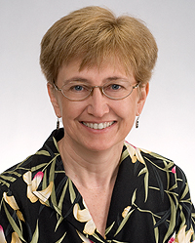
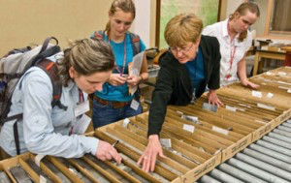
Surviving and Thriving in the Cycles
Most oil and gas professionals experience a “change” in employers at some point in their careers – but it doesn’t mean it’s a negative, its just a change.
Case Study: Dr. Kitty Milliken
Graduate with PhD from the University of Texas in 1985
Hired Exxon 1985
Released in 1986 (Exxon budget cuts)
Returned to UT as Research Assistant in 1986
Taught and performed research at UT until 2006
Joined the Bureau of Economic geology and now
Senior Research Scientist
Numerous awards
ground breaking publications
Scientific recognition
“I like research because I like uncertainty, you don’t know what it means so, you go and find out”
She was successful because she was smart, hard working, had an scientific interest and the ethics to see it through. The change in career path did not slow her down!
AAPG Explorer – May 2015
Notes:
Good representation of WF – high % of 31-40 year olds…we’re seeing an influx of new people. The societies have been working on recruitment and marketing, so some of the percentages are high for younger age groups.

Slide 55
Careers in the Geosciences
In the current contraction, the traditional tract of hiring will be more challenging, decide if the energy industry is right for you, and if so, consider a tangential path (business, statistics, environmental, management) that can get you to a successful career and make you a stronger, more desirable geoscientist.
Consider altering your academic path by adding additional classes, another degree, or post-doc work. Look for academic research projects that gain you additional experience.
Careers in government, non-profit, and academia are less affected by oil. and gas prices and provide alternately rewarding career paths.
Evaluate your career desires, and don’t be afraid to try new avenues that can strengthen and broaden your skill set. These connections and skills will be valuable assets during the next industry expansion!
Notes:
Energy companies need to adapt; and to build strategically for the longer term
we not only need to control capital and costs, but to set a clear direction.
This Outlook is therefore valuable in giving us an insight into the most likely shape of the future energy landscape and some of the most important changes expected over the next 20 years.

Slide 56
Career Opportunities in the Energy Industry
Addressing the concerns of early professionals and students
Section 3
How to get Started

Slide 57
Outline
Industry Outlook (Section 1)
  Where is the market going in the near and long term?
  What are some of the causes of the current contraction?
Careers / Jobs in the Geosciences (Section 2)
  Geoscientist across the economy and in Government, Academia, and Industry
  Broaden you experience and reach your desired level of education
How to Get Started (Section 3)
  Personal Stories
    Story 1
    Story 2
  Interviewing
  Placement
  Networking
  Young Professionals (YPs)
Q&A

Slide 58
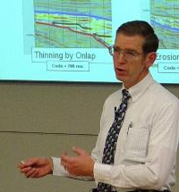
Personal Stories
Two Examples of how experienced geoscientist had both exciting and rewarding careers in exploration and academia even with the complex nature of the oil and gas industry!

Slide 59






Example 1 – A Training & Career Path
1968
4 years,
B.S. in Engineering Physics
5 years, M. Phil. and
PhD in Marine Geology
32 years, EPR-URC
Seismic R&D, Training
6 months as a
Visiting Lecturer
3 years as a
Tutor
3 years as a
Geological Advisor
2015

Slide 60
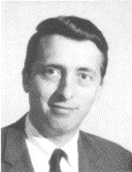
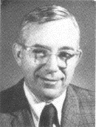
Coming Out of Grad School
I Was Triple Blessed:
  Industry just started a hiring boom
  I received an offer from Exxon Research
  I was assigned to the Seismic Stratigraphy section and was mentored by:
The Fathers of
Seismic Startigraphy
Pete Vail
Bob Mitchum

Slide 61
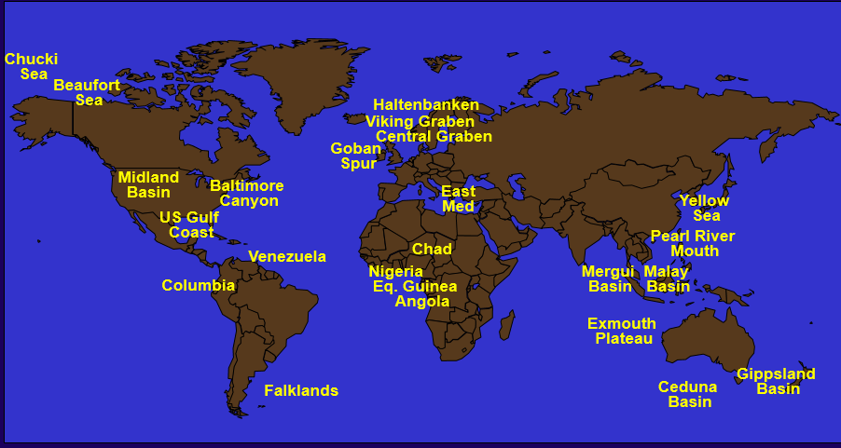
My Areas of Study
Specialties
Main Tasks
Seismic Interpretation (2D & 3D)
Seismic Stratigraphy
Basin Modeling
Seismic Attribute Analysis
Volume Interp & Visualization
R&D New Interp Methods
Apply New Interp Methods
Training/Mentoring
Basin I’ve Studied 6+ months

Slide 62
Finding and nurturing my passion for geology:
A career is a life long Journey
The Future
Re-defining my passion
Volunteering with AAPG
STEM Education
Ceramics / Gardening
32 year career as a
Geologist / Executive in the Energy Industry
My Age
Exposure to diverse aspects of geology
Independent research / Field work
Great people
Freshman physical geology class hooked me
M.Sc. & B.Sc. Geology
Pre-college
Summer programs in oceanography
Natural aptitude for science
Encouraging parents
7th grade science teacher
Jacques Cousteau and Diver Dan TV shows
Notes:
There is a great U-Tube video that I recommend you watch called ‘Why you will fail to have a great career’ | Larry Smith |
Pursue your passion, dream, etc….
A great career is not luck…..
You don’t have to be a genius, completely competent works just fine
You do not need to be weird, nice and normal works fine
Distinguish Interest vs. passion (greatest love, highest expression of your talent).
My passion evolved over time from my personal joy at being a practicing geologist to creating an environment that enabled others to do extra-ordinary things and have great careers

Slide 63
Formal education… building a solid foundation
M. Sc.
Geology
  Geophysics
  Micropaleontology
  Geol. Oceanography
  Basin Analysis
  Seminars:
    Paleontology
    Geochemistry
  Thesis: Fluctuations in the West Antarctic Ice Sheet during the Miocene: Evidence from ice rafted sediments
  Teaching Assistant
  Physical Geology and Mineralogy Labs
B. Sc.
Geology
  Geology
  Senior Thesis
  Optical Mineralogy
  Petrology
  Structure
  Stratigraphy
  Geomorphology
  Oceanography
  Micropaleontology
  Sedimentology
  Coastal Processes
  Mineralogy
  Historical Geology
  Physical Geology
  Science & Math
  Physics
  Chemistry
  Biology
  Introduction & Intermediate Calculus
  Liberal Arts
  Native American Religions
  Imperial Russia
  Survey Art History
  French (3 years)
  Economics
Years
Notes:
Recently I ranked 25 grant requests for the AAPG Grants in Aid Foundations. Applications that stood out included…..
Pursue a broad geoscience curriculum as an undergraduate with courses
Develop good quantitative skills. Some seismic workstation and the ability to interpret seismic data
A summer field course is highly recommended.
Working in industry is ultimately about pursuing projects that will make money for your company’s shareholders. Take an economics class and know how to build an Excel spread sheet and read a profit and loss statement.
Learn to make, and feel comfortable, giving presentations before a group that will ask lots of questions about your assumptions and conclusions, and probably challenge them.
Develop the ability to write a clear, concise and credible report. You must convince management that the expense is justified to prove why you believe there is a commercial mineral opportunity as a result of your geoscience work.
Participate in the activities of your university geoscience club. Become an officer!
Get involved with professional societies as a student.
engage in original research projects as an undergraduate in fields that you might want to pursue in graduate school, and possibly as a career.
Give poster presentations at the regional and national meetings of the geoscience societies. Get published by helping your professor write a paper.
Work during the summers as a laboratory research assistant; field assistant, or as an intern in a geoscience discipline
An undergrad, the job might be fairly menial – i.e. collecting and analyzing samples, but that is where one has to start, and it can be lots of fun if you are posted to some remote site in Alaska or Greenland, or on a research ship.
Develop a passion for the geosciences and be committed.
Undergrad Level
Excel in all your courses – high GPA, Take fundamental, classic geoscience courses
Get exposure to all disciplines – attend seminars
Scan professional society journals – take note of who is working on topics that interest you
Choose a “senior topic” that you have a lot of interest in, work it well, be creative and application-minded
Grad Level
Choose a high-caliber university with a great geoscience department
Take courses that will give the depth & breadth Look for way to demonstrate leadership potential
Get some good work experience – internship
Choose a research topic that we have passion for; better to have a superb thesis topic on something unrelated to industry than a mediocre thesis
Polish your resume/CV – sell yourself Gain interviewing experience
Critical Skills:
Critical thinking
Problem solving
Effective communication
Think like a scientist: (multiple working hypotheses)
Integrate diverse data
Possess quantitative ability
Seek continuous learning
Able to use GIS

Slide 64
Staying competitive throughout a career requires continuous growth
Stay technically relevant
Develop your interpersonal and
communications skills
Be involved
  Business School / Leadership
  Manager of the Future
  Change management
The New Global Business Environment
Leading Innovative Organizations
Developing Managerial Excellence.
Developing International Leadership Skills
  Professional Associations / Community Involvement
BP Federal Activities
Global subsurface technology network
Global business initiative to improve the role of women
University recruitment
Community Involvement
Science by Mail Program mentor Houston Children's Museum
Career Mentor: Booker T. Washington High School
Houston Geological Society: Continuing Education Committee
Professional Affiliations
AAPG, local societies
  Personal Development
  Ethics
  Inclusion
Breakthrough training
Communicating effectively under pressure
Basic and advanced facilitation
Diversity awareness
Facilitation
Career Years
  Technical
  Lots of geology courses
  Drilling practices
  Reservoir engineering
  Petroleum economics
Keep your technical skills sharp and understand what other disciplines do
Notes:
Strong basic-concept training: (don’t specialize too soon)
Critical thinking and problem solving ability: (applying scientific method)
Constant updating and expansion of skills and knowledge:
Your career development is your responsibility !
Competitive-edge in several skills: (must evolve with employer’s needs)
Special discipline (structure, geochem., etc.)
Quantitative (geologic modeling, geophy. processing, risk assessment)
Workstation (computer interpretation, programming, problem solving)
Excellent communication skills:
must be able to ‘sell’ your ideas
Oral, written, graphical
Develop your personal Development plan
Someone asked about how I stayed open to new ways of doing things.
The best way is to continuously expose yourself to new things and people with different opinions than you have.

Slide 65
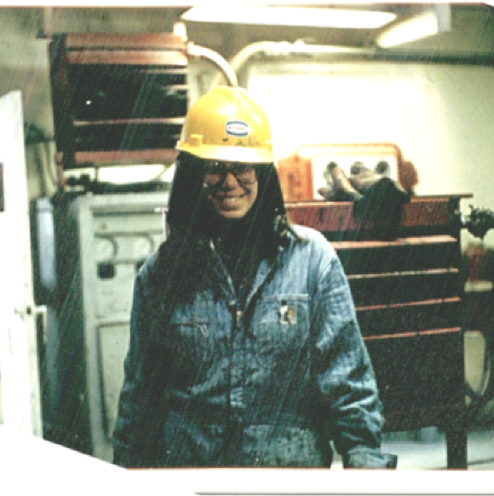
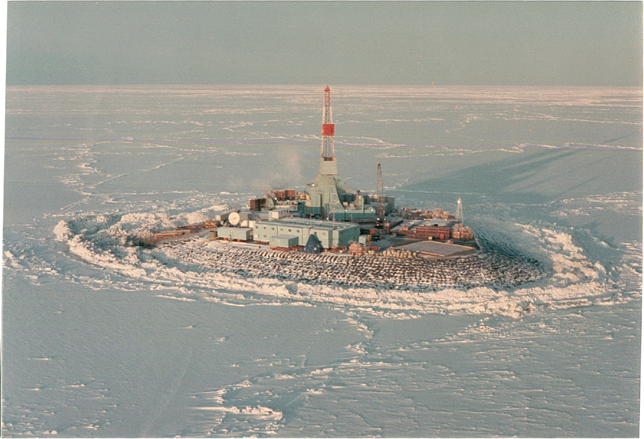
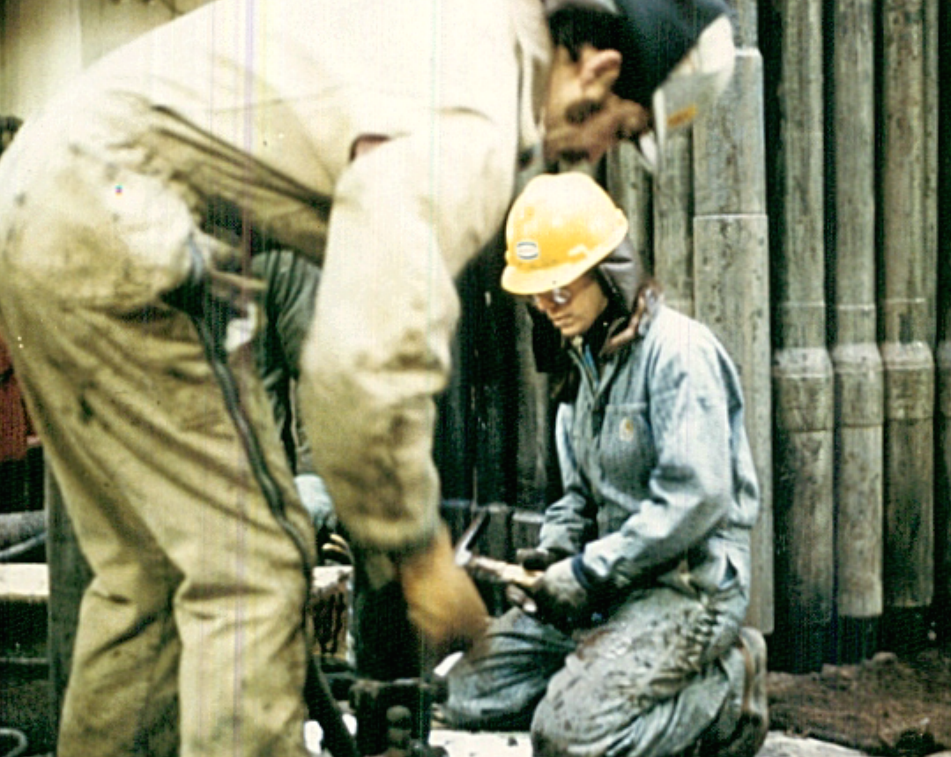
The start of my career !
Wide eyed 24 year old
1st job as a well site geologist on the North slope of Alaska in 1981.
Notes:
With a career path, once dominated by males, that spans over three decades I am sure Mrs. Judson has experienced her fair share of gender discrimination. If this is the case, I am interested in knowing how she dealt with the adversity of constantly having to prove herself as a female geologist.
There are many time in my career where I acutely felt discriminated against being a woman…. This happened mostly in my career as I was proving myself, establishing a track record, and developing my network.
I entered the work force before a lot of the EEO regulation was put in place.
It is interesting to read a lot of the books written by women today “Lean in” is a good example… It is funny how the language changes but the sentiment stays the same. To this day I can hear my fathers voice quoting the Notre Dame Foot ball coach… When the going gets tough the tough get going, or my mother saying the world is your oyster, you can be and do anything you set your mind to.
Excerpt from my 24 year old self - Diary I kept during my first year as a well site geologist.
At the airport and I met the Sohio rig representative and the first words out of his mouth were were ‘not another god damn female on my rig”
Among the 1st professional American women to work offshore -- (nicknames such as Split tail, BB).
“I guess the idea of living in a male dominate (macho to the the extreme) world is still a disquieting one. The feeling that you are constantly being tested and watched leaves me on edge. I am not sure if this is all my imagination or not! Talking with other new male geologists I am not alone in being uneasy and I probably have an easier time at starting out than they do. Most of the drill hands go out of their way to answer my questions and are very helpful. I guess to most of these guys a woman on the rig is still a novel thing and they make the most of it… But everyone has to prove themselves and show that they can pull their own weight. It really doesn’t matter who, just so your job gets done properly.
Talking about the coring process. As it is, I am sore, and stiff and another core is on the way up… I have to admit, I wouldn’t give up being here for anything. It is fun, exciting, interesting challenging, definitely different. A once in a life time experience. Just being involved in Prudhoe Bay is an overwhelming when you realize how much it takes to make the whole thing go.
There are stories to be told, better over a beer !!! “
Sense of humor…. Perspective, Character forging, No winners ! This stood me in good stead years later to know when to fight my battles and when to retreat and wait for another day !
Upon reflection, when face with a challenge, I put my head down, worked really hard, focused on getting the job done, being technical credible, being generous to my team mates, and speaking the truth.
This philosophy took me from a 24 wide eyed little girl on a rig to an executive positive running BP global resource appraisal portfolio.

Slide 66
…..My Career Path
30 years
2011
Leveraging all the pieces
VP Resource Appraisal – Exploration Division
Dream Job !
VP Paleogene
Technology Flagship
Finding my leadership voice
Geoscience Technology Unit Leader
E&P Technology
Director Subsalt Technology Leadership Area
E&P Technology
20 years
2001
Growth Performance Unit Ldr.
Canada
Innovation Project
Resource Manager North American Gas
Expanding
Horizons
Exploration Group Lead Gulf of Mexico
Appraisal Team Lead Gulf of Mexico
Business Development
10 years
1991
Snr. Development Geologist
Azerbaijan
Planning Analyst
Development Geologist Central
North Sea
Learning a trade
Exploration Team Lead
Gulf of Mexico
Exploration Geologist
Gulf of Mexico
Exploration / Appraisal Geologist
Alaska North Slope
0 years
1981
Exploration Operations Geologist
Alaska North Slope
Historical BP Geoscience Career Development Map
Notes:
Career Path & Advancement
Out of all the positions you've held at BP, which was your favorite and why? Toss up between Subsalt TLA and Resource Appraisal
Subsalt TLA:
Resource Appraisal:
Which was more stressful/Demanding: Working in Explorations, or production/development?
All equal but for different reasons
Would you say your first position as a geoscientist was the most challenging or your last position as VP resource appraisal and why?
The First ! No track record, no relationship.
What was the one of the most interesting part of your 32 year career?
Diversity of challenges and evolving landscape: , People, Culture, Rocks, Technology,
What are some of the challenges I have faced?
How do you balance the various components of your life?
Who has helped me along the way?

Slide 67
Events that rocked my world and shifted my path.
Geoscience | Commercial | Technology Leadership | Asset Leadership
VP Resource Appraisal
 |  | VP Paleogene Technology Flagship
 |  | Geoscience Technology Unit Leader
 |  | Sub Salt Imaging Technology Leadership Director
 |  |  | Performance Unit Leader Canada Gas Business
 | Innovation Manager – Mid Continent Business
 |  |  | Resource Manager North American Gas
 |  |  | Exploration Group Ldr Gulf of Mexico
 | Business Development GoM
Snr. Development Geologist Azerbaijan
 | Commercial / Planning Analyst
Development Geologist North Sea
Exploration Geologist Gulf of Mexico
Operations / E&A Geologist Alaska
Creating my own future –
Declaring what I wanted to do landed my dream job
Gulf of Mexico Oil Spill
Taking a career risk led to
delivering something extraordinary
Personal illness
Learned not to be afraid to fail
Found love
Career disappointment / Not getting what I wanted forced me to broaden my skills to be more competitive
Going on an adventure
Seeing the world
Embracing the unknown.
Be flexible
Notes:
Stories - Tough Choices that shaped my career
Embracing the unknown – Not another G.D female on my rig: Story of my 1st job and then trip to Anchorage San Francisco / Be Flexible
Going on an adventure/ Seeing the world: Glasgow and Azerbaijan
Personal illness / Learned to not be afraid to fail / Found love:
Taking a career risk Delivering something Extraordinary: Be open to stepping outside your comfort zone: Taking up the role of Seismic imaging
Creating my own future – Declaring what I wanted to do:
People get out of the way of someone who know where they are going
Student Questions
In 2010, you were hired as the Vice President of Resource Appraisal, what did you do to acquire this position? Did you do something to make yourself stand out? Were you involved in the creation of the position? Why was this position created in the first place?
How did the Gulf of Mexico Oil spill effect your job? Did you have new tasks to deal with related to the catastrophe, or were you not involved?

Slide 68
A sense of adventure & a desire to see the world
2
3
Growing up
University
Lived
Visited for work
Notes:
With the extensive travel that her positions have afforded her, what is the place that upon recollection can still bring a smile to her face and why?
Baku Azerbaijan
Extraordinary people
A country at war with Armenia and itself
World class geology
The opportunity to be a part of an awesome team.
Help lay the foundation for improving the standard of living
Baku today is transformed
What is the most ‘geologically interesting basin you have work in?
Understanding how the whole petroleum system work and being a part of
All basins are interesting… They all have their remaining secrets to give up.
It becomes really fun when you have seen enough rocks to see subtle connections and challenge paradigms.

Slide 69
Personal learning
People get out of the way of someone who knows where they are going
Content matters / Stay technically relevant
Ethics matter
Be flexible and willing to step outside your comfort zone
Unexpected rewards of taking a risk
Life occurs
Notes:
What are some of the key tips that you can offer to us that you can take away from your journey through the petroleum industry?
How did you motivate people to reach out beyond what they thought was possible and embrace challenge in pursuit of an idea?
How great is the importance of being involved with the community outside from work?
In your personal experience as a professional is it important to have a work-life balance or is it more of a work-life integration atmosphere?
How did the Gulf of Mexico Oil spill effect your job? Did you have new tasks to deal with related to the catastrophe, or were you not involved?
Standing back from all of the above. I made a choice to join BP 22 years ago now. That choice has molded and strengthened my ideals, my self-confidence and my courage. My wish for myself, my family and my colleagues is the same one I wish for you…. much joy in the great game of life. But…. As with all good strategies… this one is only as good as good as the tactics you use daily to delivery them…

Slide 70
What If I Graduate Soon?
Consider extending your stay in University?
Post-doc or research positions in universities are an excellent mechanism to grow scientifically while weathering the short-term Industry cycles and lack of employment.
This will give you continued access to recruiting, computing, and further research opportunities.
Consider additional degrees – While difficult to consider, additional degrees in business, geoscience, engineering, computer science could have a great long term benefit.

Slide 71
What If I Graduate Soon?
Explore your Universities resources
Don’t neglect your University recruiting and placement offices
  Attend resume and writing workshops
  Attend out of department presentations
  Reach out to professors for advise and what they are hearing in terms of hiring
  Participate in IBA competitions in 2016
  Participate in mock interviews

Slide 72
What If I Graduate Soon?
Market yourself relentlessly!
Present your undergrad and/or graduate research at all applicable venues.
Internal symposiums
Local society meetings
As well as regional or national/international meetings
Fully spend out any presentation or development funds. Use these opportunities to network, show off your work, and hone your presentation skills.
Posters are generally more work, but in many cases, more impactful.

Slide 73
Different Types of Networking
Informal
Formal
  Conferences
  Informational Interviews
  Networking lunches
  Career fairs
  Conferences
  Out with friends
  On the street
  Anywhere

Slide 74
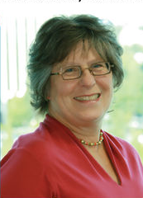
Interviews with Professionals
“It’s great to identify what [your] dream job would be, and it’s great to pursue it, but don’t pursue it too doggedly so
that you don’t see other opportunities out there … The
one thing that everyone should take away from every job they’ve ever had is that you learn something in anything you do: you should be developing some skill set that comes out of that. And you build on that. I learned much of my people management skills from being a bartender!”
Vicki McConnell, Oregon Department of Geology and Mineral Industries
Now incoming Executive Director at the Geological Society of America
Notes:
Remember to give them a few seconds to read the slide.
Transferrable skills – goes back to the infographic discussion
These are also in the packets – with more quotes!

Slide 75
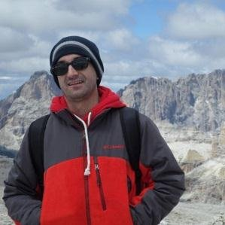
Interviews with Professionals
“At the end of the day, the most important [elements to being extended a job offer are] a combination of your technical skills plus your people skills. Clicking with a recruiter is the most important step to go forward in the interviewing process ... A recruiter friend of mine told me, ‘I know with[in] only the first 2 minutes of meeting a candidate if I will call him/her for a second interview.’”
- Juan Herrera, Schlumberger
Notes:
Abby Go:
Choose one about Communication: Probing question – What are your thoughts on this? Did you realize that communication was THIS important in your geo career?
Choose one about Desired Skills: Probing question – Can you think of any other skills that might give you an advantage in the job market?
Choose one about Networking: Probing question – Who here can name a good contact that you already have that could help you in your job search?
Emphasize: Do you have any suggestions or advice for me on how to make myself more marketable?

Slide 76
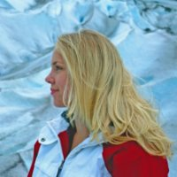
Interviews with Professionals
“COMMUNICATION, communication, communication.
When you’re in undergrad for a technical degree you’re
sitting there and you’re stressing over, ‘how am I going to be
a better forecaster and what computer language do I have to
learn next?’ Honestly, at my job I spend most of the day communicating with customers. And it was nerve-wracking at first, learning how to explain technical information to a lay person is really important, and that’s something you don’t learn in undergrad.”
- Carrie Suffern, National Weather Service
Notes:
Abby Go:
Choose one about Communication: Probing question – What are your thoughts on this? Did you realize that communication was THIS important in your geo career?
Choose one about Desired Skills: Probing question – Can you think of any other skills that might give you an advantage in the job market?
Choose one about Networking: Probing question – Who here can name a good contact that you already have that could help you in your job search?
Emphasize: Do you have any suggestions or advice for me on how to make myself more marketable?

Slide 77
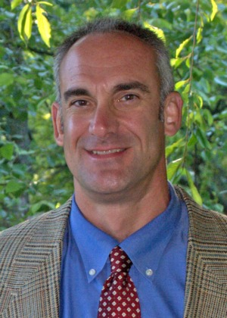
Interviews with Professionals
“If students want to get into the environmental or consulting field, I would recommend that they… Find
engineering and consulting firms in their area. And not necessarily look for somebody that is advertising, but
just find a contact with each company, send a cover letter and a resume, and then follow up with an email and a phone call. A lot of opportunities don’t get advertised. If your resume crosses a desk, and somebody’s looking to fill a position, you can get a job without having to wait for something to be advertised … That’s the networking thing: Get your qualifications out to as many people as you can [and] talk to as many people as you can.”
- Mike Lawless, Draper Aden Associates
Notes:
Networking!!! Many jobs aren’t posted! It’s by word of mouth.
This leads us into networking!

Slide 78
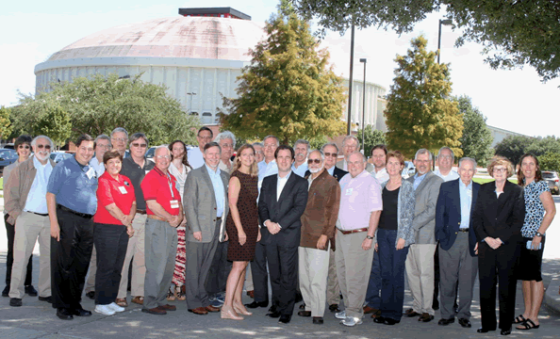
What If I Graduate Soon?
Consider volunteering
on committees!
Network – Get involved in your local
Societies (Scholastic, Environmental,
or Geological).
GCAGS Annual meeting 2014
If you have an interest in working in the Energy Industry – Look for AAPG affiliated societies in your area. They are some of the best ways to meet more experienced geoscientist and make long lasting connections. Offer to work on committees and convention teams.
While degree and scholastic performance may be most critical for the first opportunities, Typically your second job will be based on reputation and your network of connections.

Slide 79

Local Society Networking Events
http://www.aapg.org/about/aapg/leadership/sections
Refer to this website for a list of all Sections
http://www.aapg.org/about/aapg/leadership/regions
Refer to this website for a list of all Regions
Many jobs (possibly 90%) are not
advertised and only acquired through
networking. There are hidden
opportunities at all times during your career

Slide 80



AAPG Services
AAPG Career Center
Resources
Job postings
Recruiter information*
Available at meetings
AAPG Division of Professional Affairs
Layoff Triage Tool*
AAPG Education Services
Career-focused digital newsletter*
*Not yet available
Notes:
What can AAPG offer, services?

Slide 81
Networking
Where can I network with professionals outside of the AAPG? Consider YPE
YPE members have access to a network of 40 chapters worldwide with: Engineers, landmen, financial analysts, lobbyists, governments employees, accountants, attorneys, commercial and investment bankers, A&D professionals, principal investors, consultants, roughnecks,

Slide 82
Young Professionals in Energy
Mission:
YPE aims to facilitate the advancement of young professionals in the energy industry around the world through social, educational and civic service oriented events.
Vision Statement:
YPE prepares its members to be the best leaders for their communities and for the global energy industry.

Slide 83


Societies with YP and Student Opportunities
Networking
Education
Speaking
Travel and grants
Cross-discipline
Research opportunities

Slide 84
Networking
What is networking? It is NOT you trying to get something out of someone else! It is you promoting yourself and getting to know people who can benefit by you and your expertise. It is a WIN-WIN situation.
Networking:
-Is a spectrum of activities
-Begins with an informational, informal interview or introduction
-Is a series of correspondence and actions that add value to both relationships
-Ends only when one or both parties 'drop dead'
What to do?
-Get on LinkedIn ASAP; your resume is your profile
-Make a customized Linkedin URL
-Make contacts by sending customized messages

Slide 85
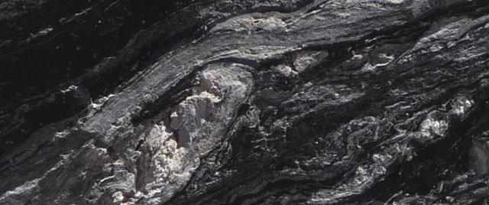
AAPG Career Training
When times are tough,
get educated!
Lots of available courses offered through AAPG:
http://www.aapg.org/career/training#2168214-in-person-training
Bear Trap Scholarships offered for many Courses and forums – highly discounted rate for individuals who have been laid off
Richard Green – Reservoir Eng. for Petr. Geo

Slide 86
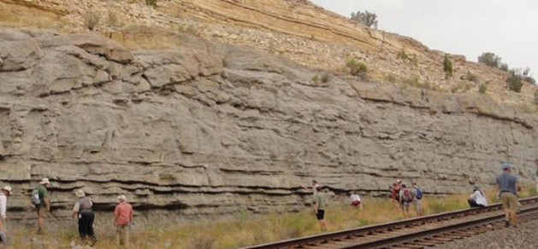
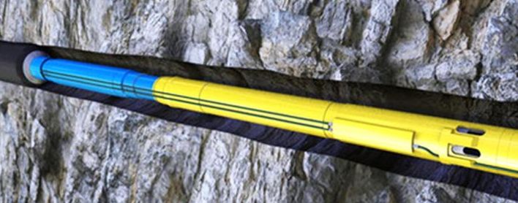
AAPG Short Courses
Short Courses – One to two day course covering a broad list of topics:
  http://www.aapg.org/Career/Training/In-Person/Short-Courses
Field Seminars – Locations around the globe to key in on geological understanding and scale:
  http://www.aapg.org/career/training#Field Seminar
Forums – Attend talks to brush up on up to date topics across the industry:
  http://www.aapg.org/career/training#Forum
Workshops - Classroom courses that strengthen understanding of specific basins and/or geologic interpretation skillsets:
  http://www.aapg.org/career/training#Workshop
Online Courses – Cheaper alternative to workshops for those looking to further knowledge in various industry skills:
  http://www.aapg.org/career/training#2168215-online-training

Slide 87
AAPG Short Course Discounts
Discounts Available to Students
  Student member discounts – reduction of cost for student members
  Grad student projectionist program – help to make courses run more smoothly, and in exchange, be able to take the course
“Get out of the Bear Trap” Discount – discount for industry professionals laid off during the down turn – up to a 75% discount on course costs!

Slide 88

Students and YPs:
How to “weather the storm”
Hiring freezes and layoffs can happen in any industry, but there are a few things recent graduates and YPs can do to help improve their chances of getting and maintaining employment:
Stay involved in professional and local societies
Volunteer for committees
Be engaged in internal groups
Acquire a broad set of skills
Take continuing education courses
Demonstrate curiosity and a desire to learn
Cultivate leadership and entrepreneurial qualities
Network with individuals in multiple aspects of the industry
Be active in the community and stay busy
Don’t panic!
Notes:
What should YPs and student grads do to insulate themselves as new hires?

Slide 89
Be positive and fight on!
Forecast is for a steady demand for Geoscientists over the next 30 year.
  Short term may be challenging
Diverse geosciences career options exist
Find and follow your passion, love what you do!
Be technically strong and grow scientifically
Remain competitive by gaining new skills
Develop a strong network and stay connected
Be involved, Be involved, Be involved

Slide 90
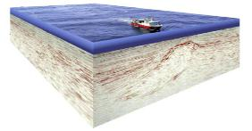
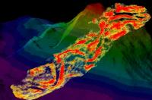
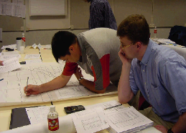
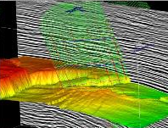
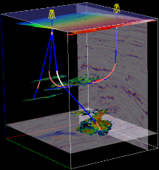
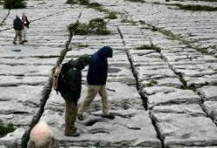
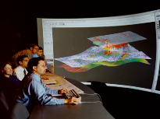
Questions?
Most Images Courtesy of ExxonMobil

Slide 91
Possible Questions from Students
Career Path & Advancement
Did you do something to make yourself stand out?
How did you end up studying Geology?
What are some of the key tips that you can offer to us that you can take away from your journey through the petroleum industry?
Which was more stressful/Demanding: Working in Explorations, or production/development?
With the extensive travel that her positions have afforded her, what is the place that upon recollection can still bring a smile to her face and why?
Geology/Technical/Technology Questions
What is the most "geologically interesting" basin you have worked in?
Would you advise students to be technologically savvy if they're majoring in the geosciences? For example, knowing how to code and learning GIS?
What motivated you to find a new imaging technology strategy? Was there a specific point in your career or research where you realized a change in strategy needed to be explored?

Slide 92
Possible Questions from Students
Organizational Leadership, Community Engagement, and Work-Life Balance
How did you motivate people to reach out beyond what they thought was possible and embrace challenge in pursuit of an idea?
How great is the importance of being involved with the community outside from work?
In your personal experience as a professional is it important to have a work-life balance or is it more of a work-life integration atmosphere?
What is the best strategy for students interested in petroleum geology careers during a downturn like now?
Clearly, there are reduced immediate opportunities to be hired, so what is the best course of action for a student not fortunate enough to get an offer for an internship or full-time position?
What initial career path would best prepare them and make them most attractive to be hired when things turn up again?

Slide 93
Career Opportunities in the Energy Industry
Addressing the concerns of early professionals and students
Additional material
“What Geoscientist do”

Slide 94

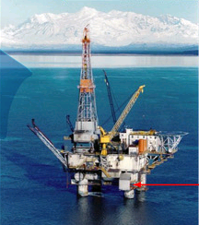

What We Do in the Energy Industry
Production
Marketing
Exploration
Refining
Upstream
Downstream

Slide 95
What We Need for Success
A Very Simple View
Correctly
Placed
Wells
A “Container”
From Which
Oil & Gas
Can Be
Produced
Reservoir
Trap
Seal
“Plumbing” To Connect
the Container to the Kitchen
Migration
A “Kitchen”
Where Organic
Material Is
Cooked
Source

Slide 96
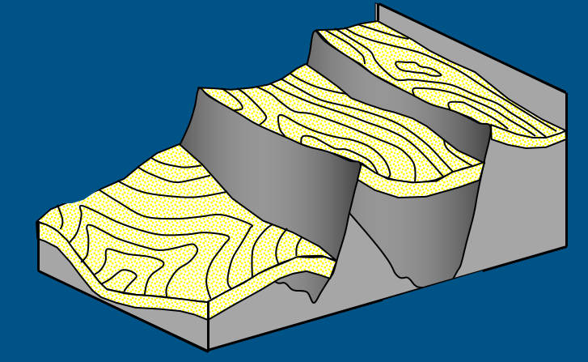
Example: North Sea
Brent Sandstone
Reservoir rock
Migration Pathway
Coals can generate gas
Schroeder & Sylta, 1993
Notes:
Slide 10
Here is a block diagram of one of the HC systems on the Norwegian side of the North Sea
The main Jurassic reservoir is the Brent sandstone
Extensional normal faulting causes the Brent to stair-step down from east to west
On top of the Brent are two organic-poor shales – the Heather and Sognefjord shales
Then the Draupne organic-rich shales was deposited – the main source rock
There are also some coals in the Brent that generate gas
HC generation – oil from most of the Draupne and some gas from the Brent coals
HCs migrate through the Brent sands and up fault zones
In the deeper traps, gas flushes out the oil resulting in deep gas fields
Shallower traps are filled with oil – even where the source is immature (highest fault block)

Slide 97
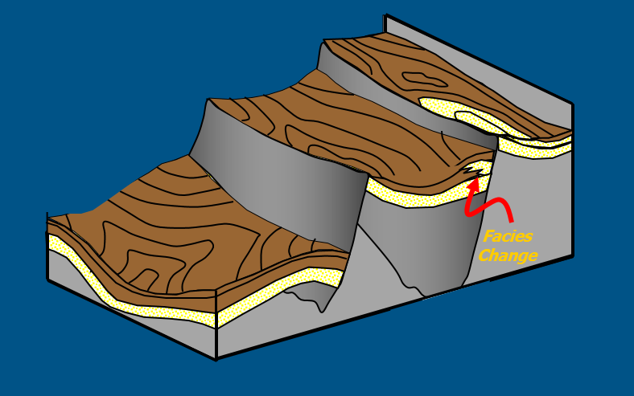
Example: North Sea
Heather & Sognefjord Shales
Organic poor
No HC potential
Schroeder & Sylta, 1993
Notes:
Slide 10
Here is a block diagram of one of the HC systems on the Norwegian side of the North Sea
The main Jurassic reservoir is the Brent sandstone
Extensional normal faulting causes the Brent to stair-step down from east to west
On top of the Brent are two organic-poor shales – the Heather and Sognefjord shales
Then the Draupne organic-rich shales was deposited – the main source rock
There are also some coals in the Brent that generate gas
HC generation – oil from most of the Draupne and some gas from the Brent coals
HCs migrate through the Brent sands and up fault zones
In the deeper traps, gas flushes out the oil resulting in deep gas fields
Shallower traps are filled with oil – even where the source is immature (highest fault block)

Slide 98
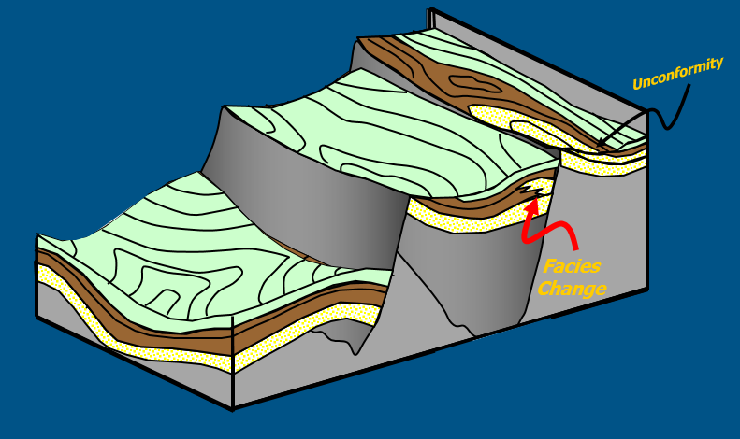
Example: North Sea
Draupne Shale
Primary Source Rock
More than 15% organic matter
Can generate oil & gas
Schroeder & Sylta, 1993
Notes:
Slide 10
Here is a block diagram of one of the HC systems on the Norwegian side of the North Sea
The main Jurassic reservoir is the Brent sandstone
Extensional normal faulting causes the Brent to stair-step down from east to west
On top of the Brent are two organic-poor shales – the Heather and Sognefjord shales
Then the Draupne organic-rich shales was deposited – the main source rock
There are also some coals in the Brent that generate gas
HC generation – oil from most of the Draupne and some gas from the Brent coals
HCs migrate through the Brent sands and up fault zones
In the deeper traps, gas flushes out the oil resulting in deep gas fields
Shallower traps are filled with oil – even where the source is immature (highest fault block)

Slide 99

Example: North Sea
HC Generation & Expulsion
Gas expelled from Brent Coals
Oil & gas expelled from Draupne
Schroeder & Sylta, 1993
Notes:
Slide 10
Here is a block diagram of one of the HC systems on the Norwegian side of the North Sea
The main Jurassic reservoir is the Brent sandstone
Extensional normal faulting causes the Brent to stair-step down from east to west
On top of the Brent are two organic-poor shales – the Heather and Sognefjord shales
Then the Draupne organic-rich shales was deposited – the main source rock
There are also some coals in the Brent that generate gas
HC generation – oil from most of the Draupne and some gas from the Brent coals
HCs migrate through the Brent sands and up fault zones
In the deeper traps, gas flushes out the oil resulting in deep gas fields
Shallower traps are filled with oil – even where the source is immature (highest fault block)

Slide 100

Example: North Sea
HC Migration to Traps
Percolates into Brent sands
Molecules move through Brent sands and up fault planes
Schroeder & Sylta, 1993
Notes:
Slide 10
Here is a block diagram of one of the HC systems on the Norwegian side of the North Sea
The main Jurassic reservoir is the Brent sandstone
Extensional normal faulting causes the Brent to stair-step down from east to west
On top of the Brent are two organic-poor shales – the Heather and Sognefjord shales
Then the Draupne organic-rich shales was deposited – the main source rock
There are also some coals in the Brent that generate gas
HC generation – oil from most of the Draupne and some gas from the Brent coals
HCs migrate through the Brent sands and up fault zones
In the deeper traps, gas flushes out the oil resulting in deep gas fields
Shallower traps are filled with oil – even where the source is immature (highest fault block)

Slide 101

Example: North Sea
HC Fill & Spill
Late gas displaces early oil in deeper traps
Shallow traps fill with spilled oil
Schroeder & Sylta, 1993
Notes:
Slide 10
Here is a block diagram of one of the HC systems on the Norwegian side of the North Sea
The main Jurassic reservoir is the Brent sandstone
Extensional normal faulting causes the Brent to stair-step down from east to west
On top of the Brent are two organic-poor shales – the Heather and Sognefjord shales
Then the Draupne organic-rich shales was deposited – the main source rock
There are also some coals in the Brent that generate gas
HC generation – oil from most of the Draupne and some gas from the Brent coals
HCs migrate through the Brent sands and up fault zones
In the deeper traps, gas flushes out the oil resulting in deep gas fields
Shallower traps are filled with oil – even where the source is immature (highest fault block)

Slide 102
Career Opportunities in the Energy Industry
Addressing the concerns of early professionals and students
Additional Material
Anxiety during the downturn

Slide 103


Uncertainty in the Oil Patch - How do you know you have anxiety?
Problems sleeping
Shortness of breath
Heart palpitations (racing heart)
Irritability
Nausea
Muscle tension
Inability to be still or calm
Unaddressed ongoing anxiety is
bad for your health,
bad for your relationships and
can lead to distraction on the job (refer to points 1 and 2)
Notes:
Situational anxiety is a very normal thing. Typically requires no treatment. Will disappear as a person adjusts to the situation, BUT you need to recognize it for what it is.
Anxiety is “ An emotional state manifested as giddiness, flushing, tightness in the chest, nervousness, and other physical signs.”
Anxiety may be rational. Maybe you are concerned with ‘doing well in a new job, someones illness, moving to a new community, world isssues or social and economic changes that may affect your life.

Slide 104



Healthy ways of Coping with Stressful Situations
RELAX!
Deep breathing
Music
Get a massage
Practice Yoga
Meditation (close your eyes, breath for 5 min)
Soak in a hot tub!
Escape – go to a movie, play a computer game, veg out a bit
Get Adequate Sleep – It is important to get enough rest.
Exercise Daily – it doesn’t have to be a daily marathon, but do something.
Try and eat a healthy diet.
Think about yourself – Stay calm!

Slide 105

Healthy ways of Coping with Stressful Situations
Do Your Best – Stop aiming for perfection. Just be proud of your accomplishments. All you can do is the best YOU can do.
Accept that you can not control EVERYTHING! But you can influence how you respond to things.
Put your stress in perspective. Is it really as bad as you think?
Welcome humor. A good laugh goes a long way.
Get involved – Volunteer, find ways to get involved in your community that gives you a support network and a way to process everyday stress.
Talk to someone. Tell friends and family that you are feeling overwhelmed and that they can help.

